Slide 1
KIT107
PROGRAMMING
Dr Julian Dermoudy
& Dr Shuxiang Xu
School of ICT

Slide 2
Today
MyLO
Unit Outline
  Learning Outcomes, Content, Assessment
Classes
Resources
  Books and Websites, Accounts and Proximity Cards, Software

Slide 3
1. MyLO
The University’s Learning Management System is called MyLO http://www.utas.edu.au/mylo
The MyLO site for this unit contains:
  PPT slides, assignments, lecture recordings, tutorial questions and answers, discussion forum, revision material, etc., and, the Unit Outline

Slide 4
2. Unit Outline
The Unit Outline is a ‘contract’ between us and you
We promise to deliver what’s in there at the times advertised in there
We don’t intend to deviate from that promise
  But if we must, we won’t unless we consult with you and have majority support

Slide 5
Introduction
“This unit extends the students' knowledge and experience of programming. It introduces dynamic data structures, foundational collection abstract data types, and simple object-based design, and rudimentary algorithm analysis. Programming is undertaken in Java and C and topics include: specifying and implementing abstract data types, enumerations, references and pointers, memory management, and self-referential data structures including linked lists.”

Slide 6
Prerequisites
KIT101 Programming Fundamentals or
KIT103 Computational Science or
HA/EA in TCE Computer Science (ITC315108 or ITC315113)

Slide 7
Teaching Pattern
Lectures:
  3 x 50 minutes each week for 13 weeks
Tutorials:
  1 x 50 minutes each week for 12 weeks (starting in Week 2)

Slide 8
COVID-19 (Corona Virus)
All lectures are live-streamed and available on MyLO in the Learning Hub (look for a link entitled “Echo360 Recordings (ALP)”
Tutorials (from Week 2) will be held face-to-face (and for those unable to be on campus on-line via Zoom)

Slide 9
Learning Outcomes
On successful completion of this unit, you will be able to:
  demonstrate…
  design, develop, and maintain…
  illustrate…
  practise...

Slide 10
Learning Outcomes
demonstrate foundational computing knowledge of abstract data types and how to implement them in both an object-oriented and a procedural programming context using —

Slide 11
Learning Outcomes
  UML to capture the features and advantages of various fundamental collection abstract data types;
  Java interfaces and C header files to express them in a programming language; and
  Java class files and C source files to implement them in a programming language.

Slide 12
Learning Outcomes
design, develop, and maintain programs containing data structures by —

Slide 13
Learning Outcomes
determining appropriate algorithms and data structures in Java and C and justifying their selection;
implementing them in good programming style and by adopting relevant coding conventions; and
measuring their complexity and comparing them with other algorithms.

Slide 14
Learning Outcomes
illustrate initiative, and work independently in order to communicate effectively with a range of audiences.
practise pair-programming techniques and employ the skills of an effective team member.

Slide 15
Generic Graduate Attributes
Knowledge
Communication Skills
Problem-Solving Skills
Global Perspective
Social Responsibility

Slide 16
Content
“Programming will be undertaken in Java and C and topics include classes and objects, inheritance and class hierarchies, interfaces, events, references and pointers, printf and scanf, structures and unions, memory management, type conversions, bitwise operations, address arithmetic, single- and multi-dimensional arrays, procedural parameters, singly- and doubly-linked lists, linear collections (stacks, queues, priority queues, circular queues), non-linear collections (binary trees, search trees, general trees), Big O notation and simple time- and space-complexity determination and comparison, applications of scientific and engineering computation.”

Slide 17
Content
Week 1
Week 13
Java
C
  Revision of Object-Oriented Programming and Java
  Introduction to ADTs
  Java Interfaces
  The Stack ADT and its implementation

Slide 18
Content
Week 1
Week 13
Java
C
  Procedural Programming and C
  The Stack ADT and its implementation
  The linked-list data structure
  Other collection ADTs
  Algorithm analysis

Slide 19
Unit Structure
Introduction
  1 lecture
Data Structures and Algorithms (Part 1)
  8 lectures, 3 tutorials
C Programming
  8 lectures, 3 tutorials
Data Structures and Algorithms (Part 2)
  19 lectures, 6 tutorials
Exam Information and Revision
  3 lectures

Slide 20
Unit Structure
KIT107 develops
  Technical competency in (Java and) C programming, but it also develops
  Understandings of conceptual, abstract, and design-oriented ideas and their application and synthesis
As such KIT107 is not well suited for competence-based delivery

Slide 21
Assessment
40:60 Internal:Examination
Internal:
Exam:
  3 hours, open-book, on-line (MyLO)
Component | Weight | Due Date)
Formative task (Java) | 0% | 10/3 (week 3)
Short pair-based program (Java) | 5% | 24/3 (week 5)
Individual exam-like program (C) | 15% | 28/4 (week 9)
Pair-based program (C) | 20% | 26/5 (week 13)

Slide 22
Learning Outcomes / 45% Rule
Note that in KIT units:
  the pass mark is 50% but
  students must attain all Learning Outcomes (and get at least 45% in the combined internal and also in the exam) in order to be eligible to pass
  we don’t mark to a curve but some moderation/scaling is possible

Slide 23
Team Work
“Forming, Storming, and Norming”
  The stages of team work!
Advantages:
  Problem solving
  Healthy competition
  Developing relationships
  Individual strengths

Slide 24
Team Work
Behaviours to adopt
  Trust and dependability
  Respect and camaraderie
  Clear and regular communication
  Constructive interaction
  Optimism and openness to diversity

Slide 25
Team Work
Behaviours to avoid
  Resentment from monitoring each other’s performance/contribution
  Ignorance about the work done by others
  “Social loafing” ― allowing your team members to do more than their share of the work
Recommendation
  Don’t divide up tasks; work together

Slide 26
Pair Programming
Pair programming is an agile software development technique in which two programmers work together at one workstation
One, the driver, writes code while the other, the observer or navigator, reviews each line of code as it is typed in
The two frequently switch roles

Slide 27
Advantages
Economics
  Reduced errors
Design Quality
  Greater diversity of solution
Satisfaction
  Increased enjoyment of the task

Slide 28
Advantages (cont.)
Learning
  Increased competence and confidence
Team-building and Communication
  Practising team skills
https://www.wikihow.com/Pair-Program

Slide 29
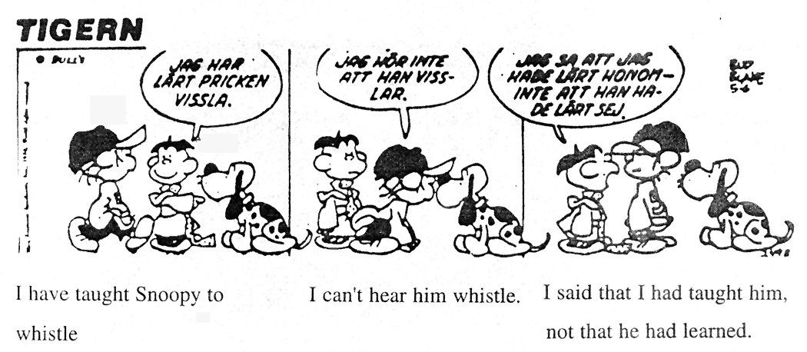
My Task or Your Task?
I've taught
Snoopy to
whistle
I can't
hear him
whistle
I said that I'd
taught him, not that
he'd learned
— Charles M. Schultz

Slide 30
What Kind of Learner are You?
“I hear and I forget.
I see and I remember.
I do and I understand.”
Do you learn best by reading, by listening, by watching, by writing, by discussing, or by doing?

Slide 31
How Will You Engage?
Lectures and Tutorials are the best opportunity for structured, supported, and interactive learning
  They are about gaining understanding, and not simply knowledge transfer
  Please attend as many lectures and tutorials as you can even though:
    All lectures are recorded (video & audio)
    All lecture slides, notes, and programs are on MyLO

Slide 32
Attendance
Attendance at tutorials will be taken and retained so that institutional queries can be responded to and so that engagement can be measured
Assignment submission (including the formative Assignment 0) will be monitored for the same reason

Slide 33
3. Classes
Lectures:
  Monday 12PM, Echo360 (MyLO)
  Wednesday 11AM, Echo360 (MyLO)
  Friday 2PM, Echo360 (MyLO)

Slide 34
Classes (cont.)
Tutorial/Practicals:
  sign up for a tutorial ASAP https://student-timetable.utas.edu.au/#Search
  attend your tutorial; links will be on MyLO before the end of Week 1

Slide 35
4. Resources
Books and Websites:
  None specifically — but any ‘C Programming’, ‘Java Programming’, ‘Data Structures in Java’, and/or ‘Data Structures in C’ text books would be helpful
  Many websites of relevance…

Slide 36
Building, Lab, and Computer Access
Student card
  Get one if you want after-hours access
  Complete the WH&S MyLO module
Username and password
  Same username for ‘central’ and ‘school’ accounts but synchronisation required

Slide 37
Building, Lab, and Computer Access
We provide file servers for your work
  Reachable off-campus with VPN
  Backed up by us
  File loss is not a reason for an extension
Printing available in the labs
  deposit money through School or elsewhere

Slide 38
Software
C
  Visual Studio 2019 for C11/C18
    available in our labs and ‘Community’ edition available at https://www.visualstudio.com/downloads/
    see also https://imagine.microsoft.com/en-us/institutions/access
  C online editor, IDE, compiler, interpreter, and REPL
    https://repl.it/languages/c

Slide 39
Software
Java
  DrJava
    available in our labs and also at https://sourceforge.net/projects/drjava/

Slide 40
Contact Details
Lecturer
  Name: ________________
  Email: _________________________
  Telephone: _________
  Office: ________________
  Consultation Hours with me (Tutors have their own times too):
    _________________
    _________________

Slide 41


If you haven’t already…
Get your student card from the Student Centre
Access our building & labs 24/7/365
00000000
BLOGGS
F.J.
Student
00000000
Expiry: 22 Jan 2024
Enable your ICT computer account and after hours access at …
(Hobart) School’s Help Desk (level 3, Centenary building)
(Launceston) kiosk opposite the Help Desk window in the foyer
Complete the Student (including Honours) information module in the Work Health and Safety - Induction & Training 2021 MyLO site
And select your tutorial time:
mytimetable.utas.edu.au/even/student

